Slide 1

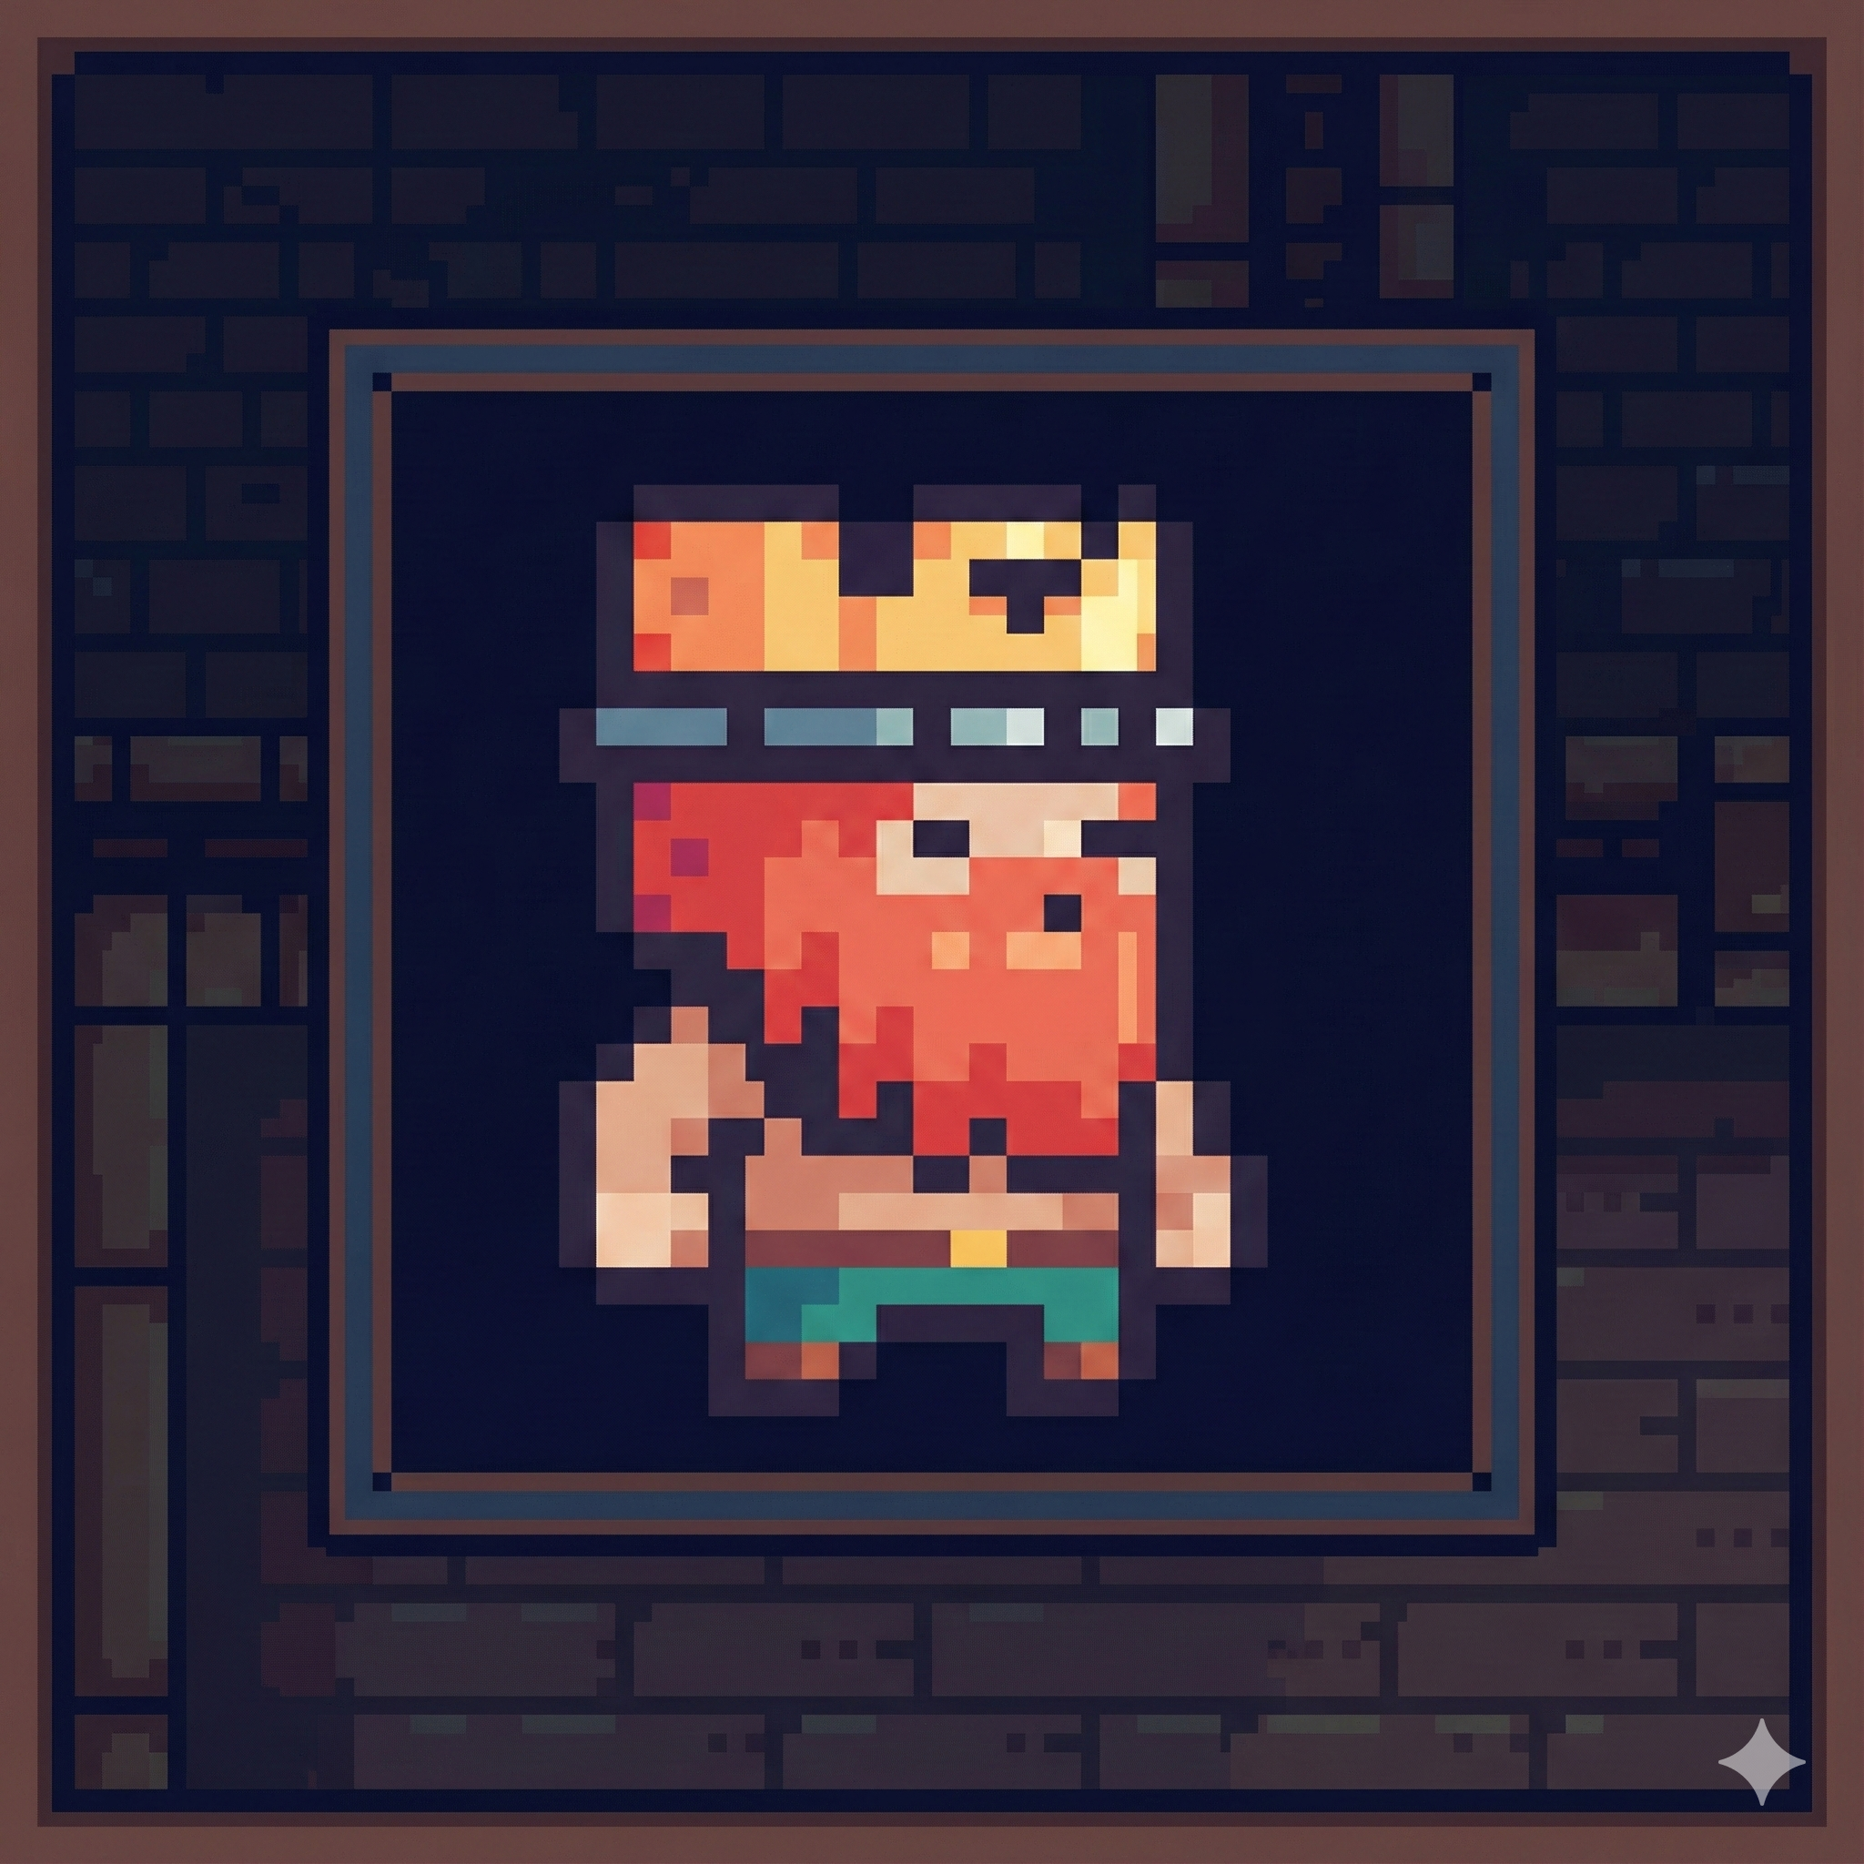
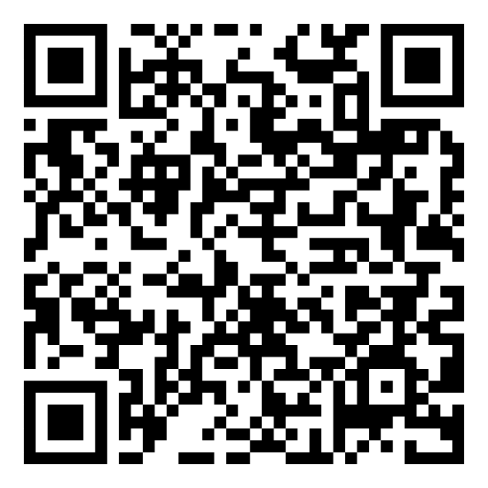
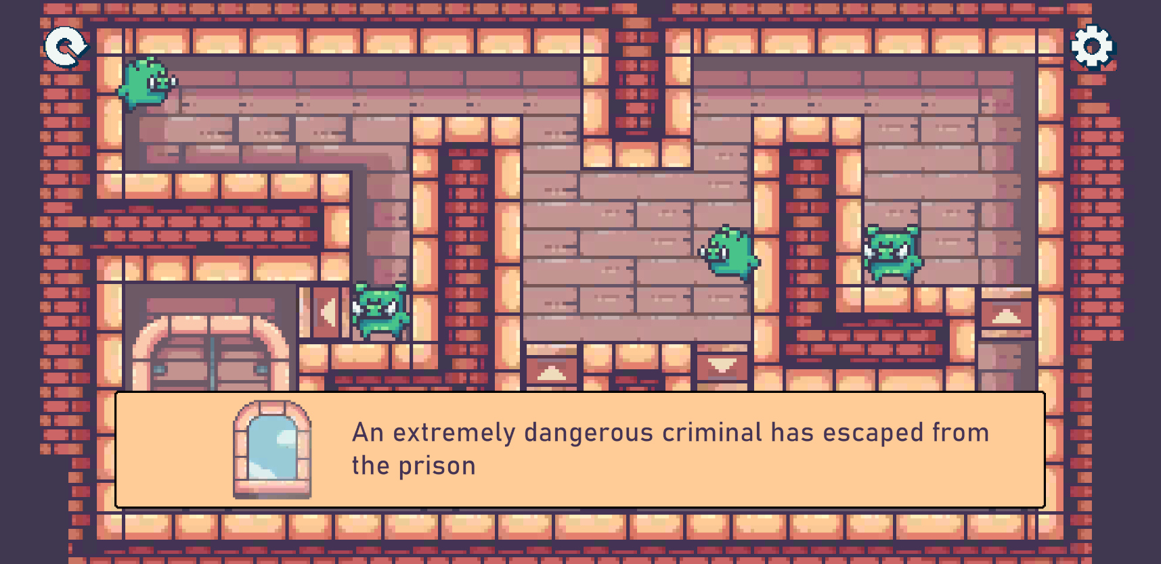

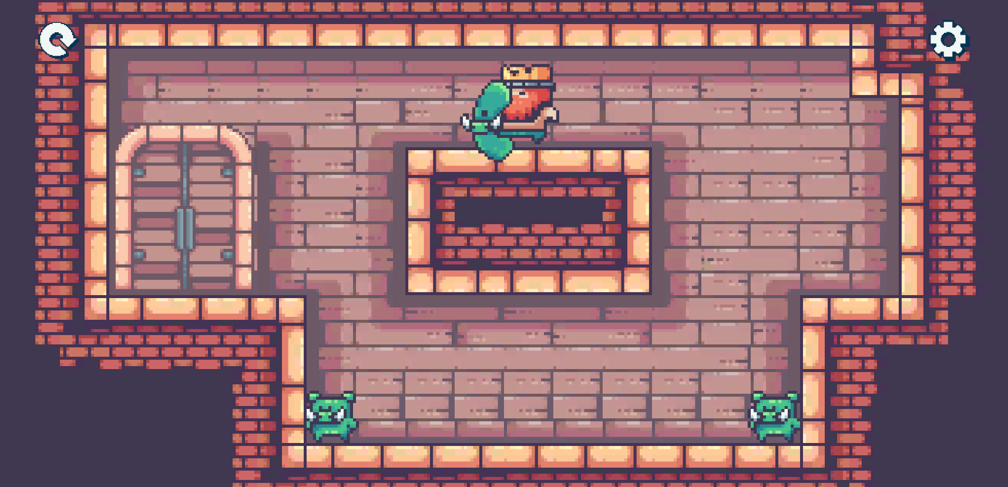
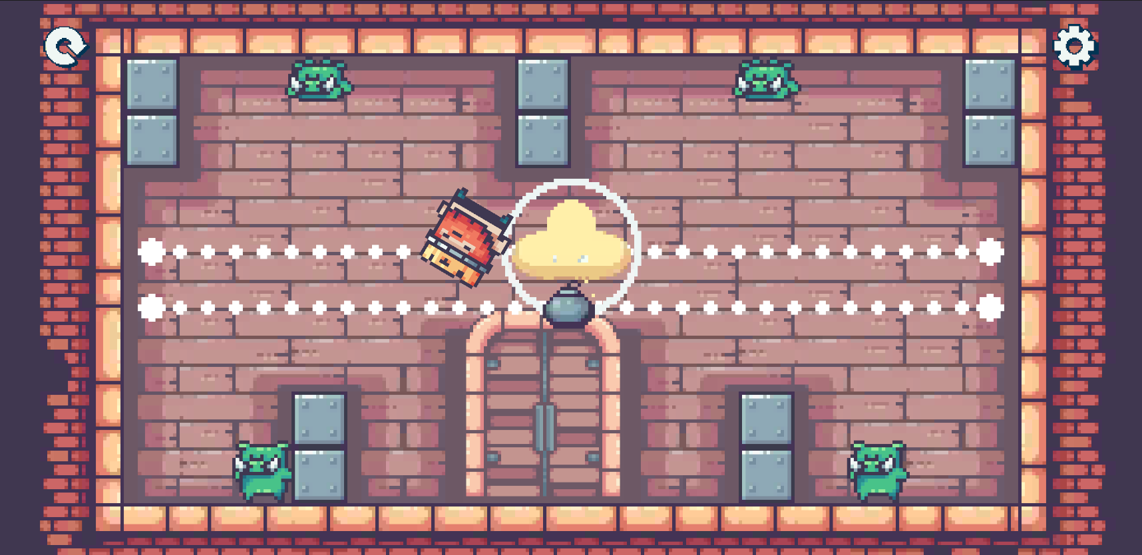

PRISON OF THE KING
Author: Nguyen Gia Hung.
Email: 24520604@gm.uit.edu.vn
Prison of the King is a strategic logic puzzle game that combines rigorous path-finding gameplay with a deep narrative. Designed to entertain and educate, the application challenges players to think critically to solve intricate puzzles while immersing them in an emotional storyline about a fallen kingdom. It features a unique bilingual system, allowing players to practice English and Vietnamese seamlessly.
DOWNLOAD FOR FREE
Features
Strategic Gameplay: Grid-based movement system requiring precise route calculation to avoid enemies and traps.
Immersive Narrative: Unfold a hidden royal mystery with humanistic values.
Bilingual Integration: Dynamic language switching (English/Vietnamese)
Level Management: A robust progression system with a "Reset" feature, allowing players to lock subsequent levels and replay the story from a specific chapter.
Auto-Save System: Automatically saves level progress, settings, and individual enemy states.
Engine
Notes:
Replace the QR code with the link to your app on SE-UIT
Replace the tech stacks section with your stack and project GitHub
This is only the template; you can design the poster in any style you want

